Slide 1
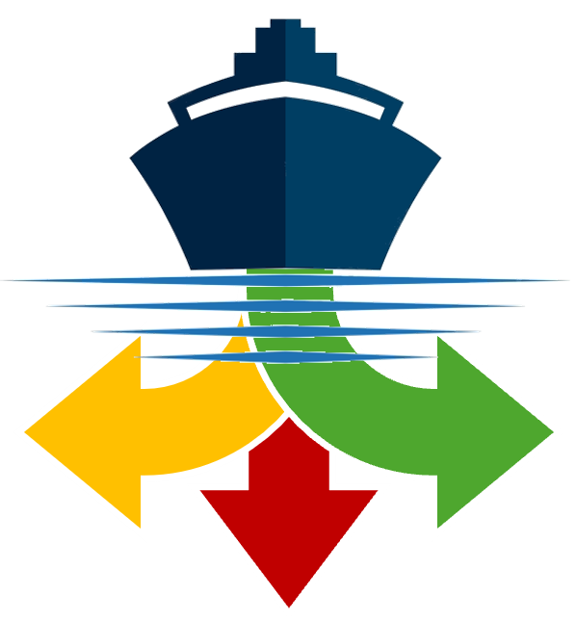




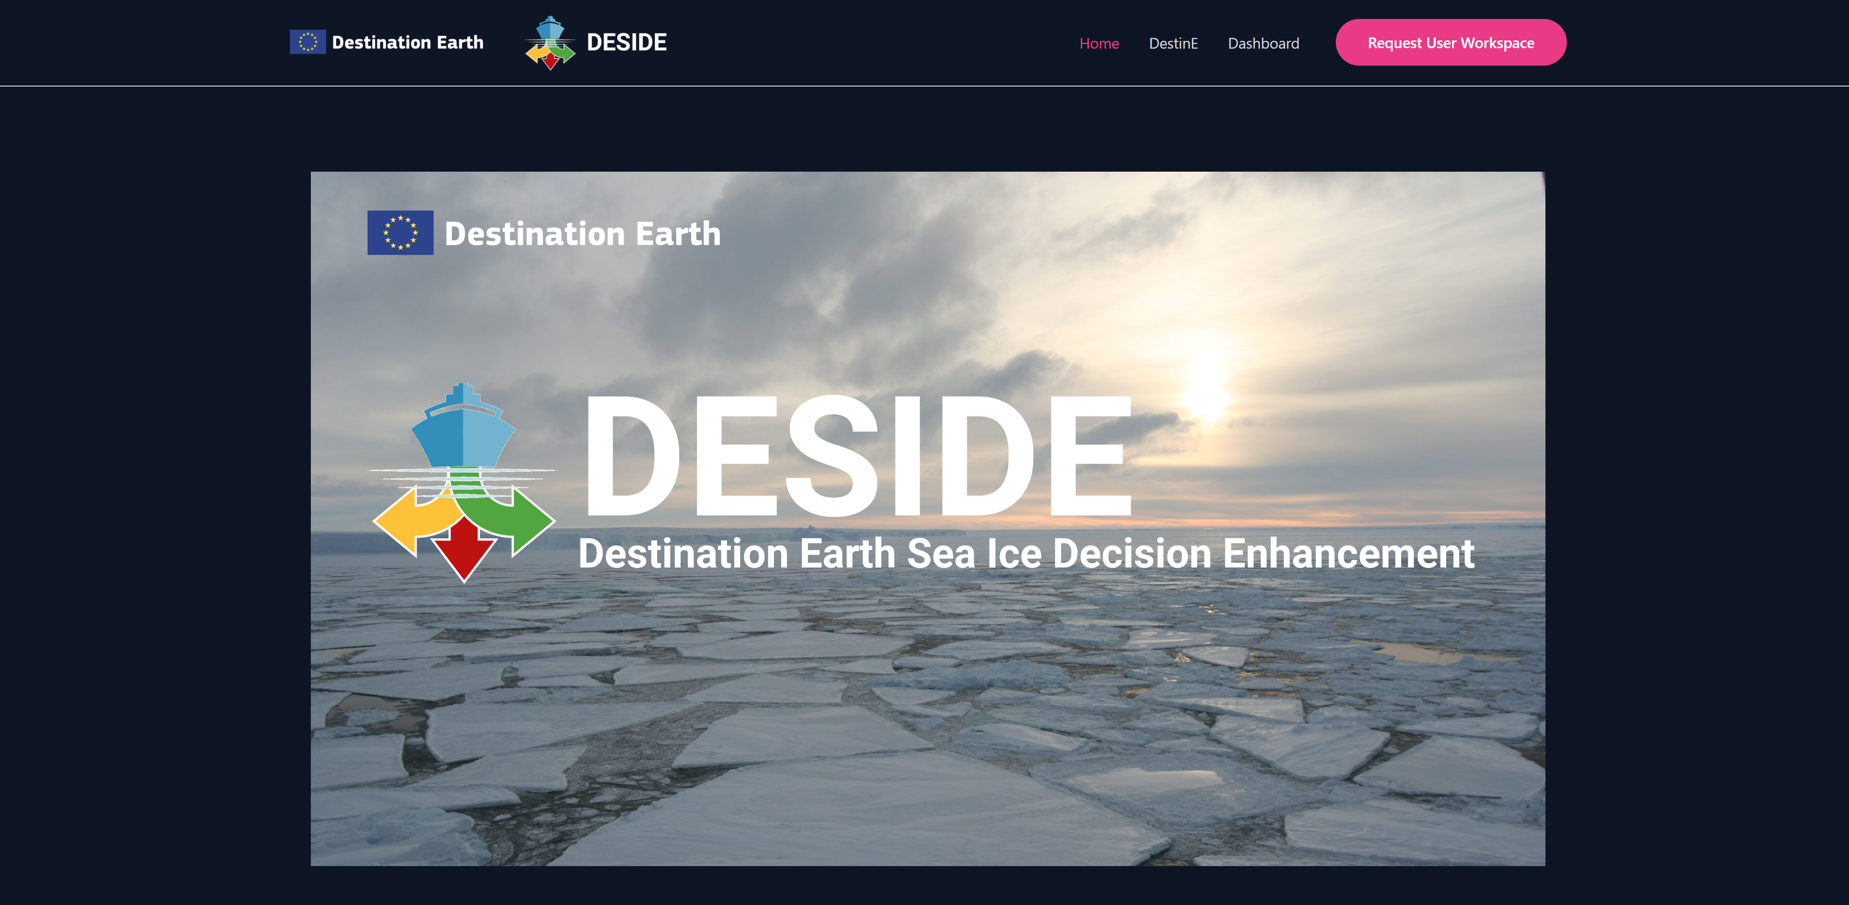





Photo: Andreas Cziferszky
Funded by the
European Union

Slide 2
DESIDE Purpose
Ships operating in the polar regions encounter hazards that present elevated levels of risk and more severe consequences when accidents occur.
Destination Earth Sea Ice Decision Enhancement (DESIDE) utilizes Destination Earth system capabilities and data to provide comprehensive sea ice and related information for policy and operational decision makers in the Baltic Sea, European Arctic Ocean, and other polar regions.

Slide 3
DESIDE Drivers
The DESIDE drivers are:
Regulatory Compliance - Deliver short and medium-term forecasts of ice, meteorological, and ocean conditions, meeting the requirements of the IMO Polar Code.
Climate Change Effects - Provide long-term forecasts on changing ice and other conditions, enabling planning and policy development for the fishing, tourism, research, and oil and gas industries.

Slide 4
DESIDE Objectives
The DESIDE objectives are:
Aggregating diverse information sources to provide common products across jurisdictional boundaries.
Producing new forecast products to improve decision-making by users.
Customizing delivery of products to different user communities based on their needs.

Slide 5
DESIDE Benefits
Benefits to polar operations and society include:
Increased Safety: Accurate information supports strategic and tactical decision-making, enhancing safety of life and property.
Pollution Reduction: Efficient route optimization minimizes fuel consumption and emissions.
Protection of Sensitive Environmental Areas: Better forecasts can help policymakers protect environmentally sensitive areas affected by changing polar conditions.

Slide 6
Navigating to the DESIDE Dashboard
deside.polarview.org

Slide 7
1. Data Visualization and Analysis
This capability allows a wide variety of datasets to be visualized and analyzed at different times and regions of interest.

Slide 8
2. Climate Indicators
The DESIDE Climate Indicators provide an integrated dataset combining sea ice climate indicators based on observations (EUMETSAT Ocean and Sea Ice SAF) and climate model projections.

Slide 9
3. Harshness Indicator
The DESIDE Harshness Indicator generates harshness maps based on wave height, sea ice concentration, and iceberg density data. The user can set the magnitude of each variable that is considered "harsh" and the weight that is given the variable.

Slide 10
4. Structure Icing Indicator
The DESIDE Structure Icing indicator assesses the risk to structures, such as ships, from freezing sea spray. The rate of ice build-up due to super-cooled sea spray freezing on contact with surfaces is a function of the air and sea surface temperatures, the wind speed, and the saltwater freezing point.

Slide 11
5. Image Warping Capability
There can be a long wait for the next satellite image to be received during which sea ice can move a considerable distance. The DESIDE Image Warp Capability transforms the current satellite image using a sea ice drift forecast to simulate what the ice in a region should look like in the future. The algorithm uses the neXtSIM model for ice drift forecasts up to six hours ahead.

Slide 12
6. POLARIS Indicator
The Polar Operational Limit Assessment Risk Indexing System (POLARIS) is a methodology to assess the risk posed to a ship by ice conditions in relation to the ship's assigned ice class. It uses the WMO standard sea ice charts as the basis for the calculation.

